Slide 1
Acceleration, Force, and Newton’s Laws

Slide 2
Demonstration
Watch what happens when I bounce a tennis ball on the desk.
What happens to its position? Direction?
What happens to its speed?
What happens to its velocity?
All of these change as the ball bounces.
Notes:
Show Brainpop= Acceleration after this slide

Slide 3
Acceleration
Acceleration = the rate at which velocity changes with time
A measure of how quickly velocity is changing
If velocity doesn’t change, there is NO acceleration
We generally say acceleration means to speed up, but in physics, it can refer to slowing down too.
Acceleration can also refer to changing direction without changing speed (ex: runner turning a corner at a constant speed)

Slide 4
Calculating Acceleration
Acceleration is calculated from velocity and time.
The change in velocity can be found by comparing the initial velocity and the final velocity of the moving object.
The time interval over which the velocity changed can be measured.

Slide 5
Calculating Acceleration
Let’s say you’re racing a classmate. In 1 second you go from standing still to running at 6m/s.
In the same time your classmate goes from standing still to running at 3 m/s.
How does your acceleration compare to your classmate’s acceleration?
In 1 second, you increase your velocity by 6 m/s. Your friend increases her velocity by 3 m/s.
Because your velocity changes more, you have a greater acceleration than your friend does.
It is important to remember that acceleration measures the CHANGE in velocity, not velocity itself.

Slide 6
Calculating Acceleration
Acceleration = final velocity – initial velocity
time
A = v(final) – v(initial)
t
Remember, velocity is expressed in units of meters per second (m/s) (just like speed but with direction), and time is expressed in seconds.
Acceleration is expressed in units of m/s over time, so they are expressed in m/s².

Slide 7
Sample Problem
Anna starts sliding with a velocity of 1 m/s. After 3 s, her velocity is 7 m/s. What is Anna’s acceleration?
Use KQS!
What do we know? Initial velocity = 1 m/s, final velocity = 7 m/s, time = 3s
What is the question? Acceleration?
Solve! A = v(final) – v(initial)
t
A = 7 m/s – 1 m/s A = 6 m/s A = 2 m/s²
3s 3s
Anna’s acceleration is 2 m/s²

Slide 8
Try these…Don’t forget KQS!
A man walking at 0.5 m/s accelerates to a velocity of 0.6 m/s in 1 s. What is his acceleration?
A train traveling at 10 m/s slows down to a complete stop in 20 s. What is the acceleration of the train?
Notes:
0.1 m/s²
- 0.5 m/s²

Slide 9
How do you change an object’s motion?
Choose an object from your desk. Change its motion in several ways:
Not moving to moving
Moving to not moving
Moving to moving faster
Moving to moving in a different direction
Describe the actions you used to change the motion.
Notes:
Show Brainpop- Force after this slide

Slide 10
FORCE
Force = a push or pull
Anytime you change the motion of an object, you use force.
Example: a pitcher throws a ball, the batter hits it, and a fan in the stands catches it. Each of these people uses force. The pitcher sets the ball in motion, the batter changes the direction of the ball’s motion, and the fan stops the ball’s motion.

Slide 11
Types of Force
Contact Force- when one object pushes or pulls another object by touching it.
Ex: Skater applies contact force as she pushes against the ground.
Gravity- force of attraction between two masses.
Ex: Earth’s gravity pulls on the skater, holding her to the ground.
Friction- force that resists motion between two surfaces that are pressed together.
Ex: Friction between the surface of the ground and the wheels of the skates exerts a force that resists the skater’s forward motion.

Slide 12
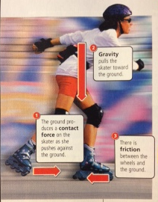
Types of Force: An Illustration

Slide 13
Balanced and Unbalanced Forces
Net Force = the overall force acting on an object when all the forces are combined.
If the net force of an object is zero, the forces acting on the object is balanced.
Balanced forces have the same effect as no force at all, meaning the motion of the object does not change.
Only an unbalanced force can change the motion of an object.

Slide 14
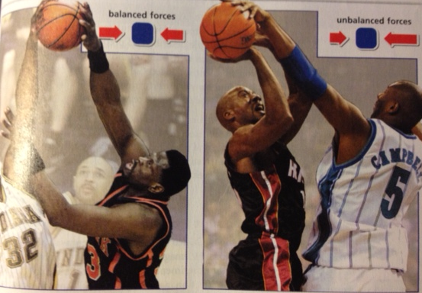
Balanced vs Unbalanced Forces
Which photograph shows a net force of zero?

Slide 15
Forces on Moving Objects
BALANCED FORCES CANNOT CHANGE AN OBJECT’S SPEED OR ITS DIRECTION.
AN UNBALANCED FORCE IS NEEDED TO CHANGE AN OBJECT’S MOTION.

Slide 16
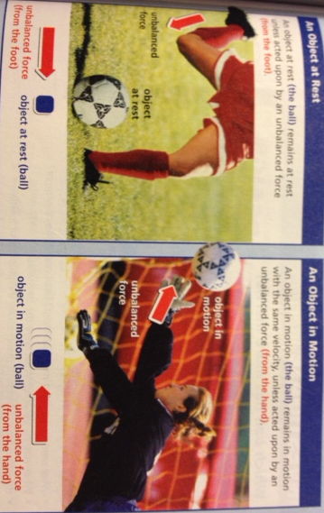
Newton’s First Law
An object at rest stays at rest, and an object in motion stays in motion at the same velocity, unless acted upon by an unbalanced force.

Slide 17
Newton’s First Law
Simply put: Applying force changes the motion of an object.
Some other examples:
You throw a stick for a dog to catch- you change the motion of the stick. The dog changes the motion of the stick by catching it and then by dropping it at your feet.
You change the motion of a volleyball when you spike it.
You change the motion of a paint brush when you make a brush stroke.

Slide 18
Inertia
Inertia = the resistance of an object to a change in the speed or direction of its motion.
Newton’s First Law is also called the Law of Inertia.
Inertia is closely related to mass. When you measure the mass of an object, you are also measuring its inertia.
The more mass something has, the harder it is to change its motion.
Ex: It’s easier to stop an empty wagon than a wagon full of sand.

Slide 19
Inertia
Inertia is the reason that people in cars need to wear seat belts.
A moving car has inertia, and so do the riders inside it.
When the driver hits the brakes, an unbalanced force is applied to the car.
The seat applies an unbalanced force to the driver (friction) and slows the driver down as the car slows down.
If the driver stops suddenly, however, friction isn’t exerted quickly enough to slow the driver. Instead, the driver moves forward with most of the original speed because of his inertia.
If the driver is wearing a seat belt the seat belt rather than the windshield applies the unbalanced force to stop the driver’s forward motion. This force is applied over a longer time and causes less damage.

Slide 20
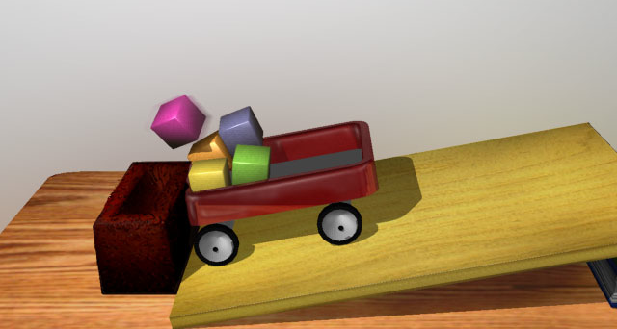
Which has more inertia, the wagon or the blocks?

Slide 21
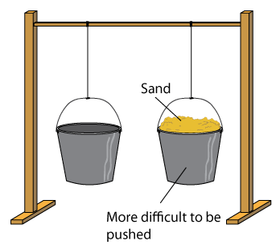
The more mass, the greater the inertia

Slide 23
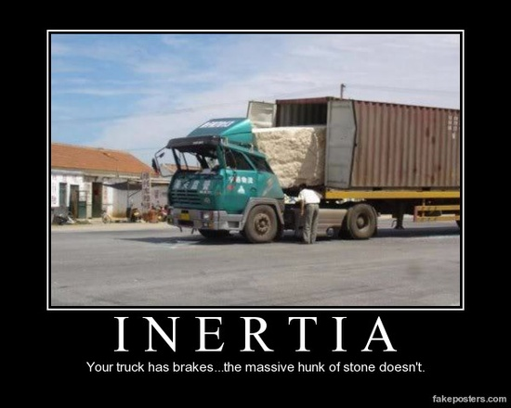

Slide 24
Video Links
http://www.youtube.com/watch?v=JGO_zDWmkvk 3:33 EdTed
http://www.youtube.com/watch?v=_QpF3m02rGI 1:44 Imagineering

Slide 25
Demonstration
I have a paper clip tied to one end of a long string, and three paperclips attached to the other end.
I will hold the single paper clip in the middle of my lab desk and let the other end hang over the edge.
What happens as I let go of the paper clip?
What happens after I add a fourth paper clip?
What is the relationship between the number of hanging paper clips and the motion of the paper clip on the table?
Notes:
The more paper clips on the other end of the string, the faster the motion of the paper clip on the table.

Slide 26
Force, Mass, and Acceleration
If you want to give two objects with different masses the same acceleration, you have to apply different forces to them.
Ex: Sliding an empty water bottle across the table requires less force than sliding a full water bottle across the table.

Slide 27
Newton’s Second Law
Acceleration of an object increases with increased force and decreases with increased mass.
The direction in which an object accelerates is the same as the direction of the force.
Simply put: Newton’s Second Law is…
F = ma
(Force = mass x acceleration)

Slide 28
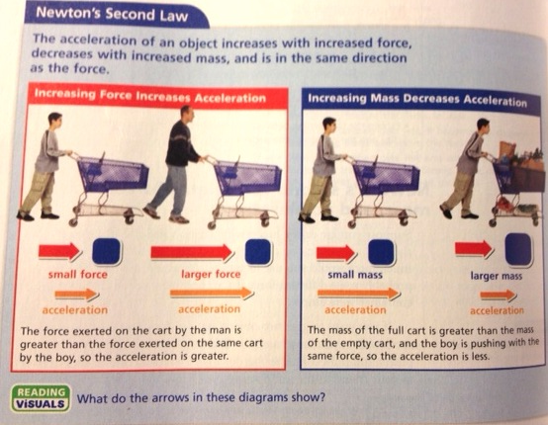

Slide 30
Calculating Force
The standard unit of force is the newton (N).
Because force = mass x acceleration, force is measured in units of mass (kg) times units of acceleration (m/s²).
A newton is the amount of force that it takes to accelerate 1 kg of mass 1 m/s².
So…. I N = 1 kg x 1 m/s².

Slide 31
Sample Problem
What force is needed to accelerate a 10 kg shopping cart 3 m/s²?
Remember KQS!
What do we know? 10 kg moves 3 m/s²
Question? Force?
Solve! F = ma F = 10 kg x 3 m/s²
F= 30 kg x m/s²
Since 1 kg x 1 m/s² = 1 N,
F = 30 N

Slide 32
Practice Problems
If a 5 kg ball is accelerating 1.2 m/s², what is the force on it?
A person on a scooter is accelerating 2 m/s². If the person has a mass of 50 kg, how much force is acting on that person?
Notes:
6 N
100 N

Slide 33
Forces can change the direction of motion
Generally we think force either speeds up or slows down the motion of an object, but it can also make it change directions.
If you apply a force to an object, the direction the object accelerates is the same as the direction of the force. This can allow an object to change direction without changing speed.
Ex: A soccer player can control the motion of a soccer ball by applying force that changes the ball’s direction but not its speed.

Slide 34
Centripetal Force
CENTRIPETAL FORCE = any force that keeps an object moving in a circle.
Without this force, the object would go flying off into a straight line.
Think of a ball tied to a string. As you whirl it in a circle, the force of the string changes the ball’s direction of motion. The centripetal force on the ball is the pull from the string.
You have to pull harder on the string when you whirl the ball faster because it takes more centripetal force to keep the ball moving at the greater speed.

Slide 35
Newton’s 2nd Law and Centripetal Force
Greater acceleration requires greater centripetal force.
A more massive object requires a greater centripetal force to have the same circular speed as a less massive object.
No matter what the mass of an object is, if it moves in a circle, its force and acceleration are directed toward the center of the circle.

Slide 36
Hmmmm…..
Talk to your group about ways you can think that something can move in one direction by exerting a force in the opposite direction.
What did you come up with?

Slide 37
Newton’s Third Law
Forces always act in pairs!
Newton’s Third Law: For every action, there is an equal and opposite reaction.
Every time one object exerts a force on another object, the second object exerts a force that is equal in size and opposite in direction back on the first object.

Slide 38
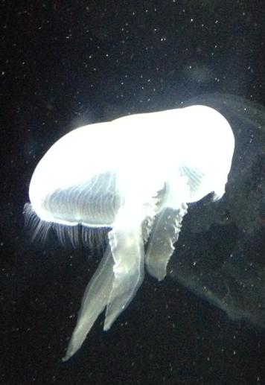
Newton’s Third Law Illustrated!
By squeezing water out of its umbrella-like body, the jellyfish applies a force in one direction to move in the opposite direction.

Slide 39
Action/Reaction Force Pairs
The force that is exerted on an object and the force that the object exerts back are known together as an action/reaction force pair.
Ex: the jellyfish pushing on the water is the action force, the water pushing back on it is the reaction force.
Action/Reaction force pairs do not always result in motion. For example, if you press down on a table, the table resists the push with the same amount of force even though nothing happens.

Slide 40
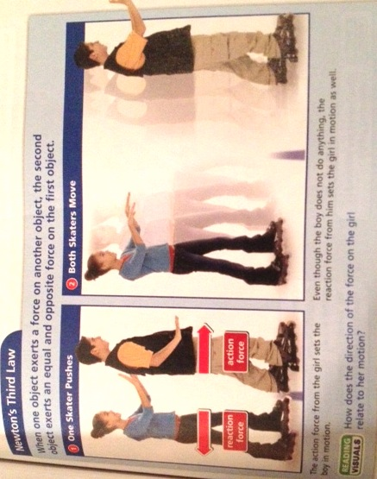

Slide 41
Action/Reaction vs. Balanced/Unbalanced
Don’t let action/reaction pairs get confused with balanced/unbalanced forces!
Balanced/Unbalanced Forces: If you and a friend pull on a backpack with the same force, the backpack doesn’t move because the forces are balanced. These forces are exerted on ONE object.
Action/Reaction: As you drag a heavy backpack across the floor, you can feel the backpack pulling on you with an equal amount of force. The action force and reaction force are acting on TWO things- one on the backpack, one on you.

Slide 42
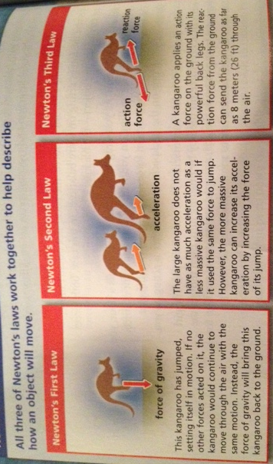
A Summary of Newton’s Laws

Slide 43
Momentum
MOMENTUM = a measure of mass in motion; the product of its mass and its velocity.
Example: If you throw a tennis ball and a wrecking ball at the same brick wall with the same velocity, the tennis ball will bounce back but the wrecking ball would likely destroy the brick wall. This is because the wrecking ball has more mass. You can’t change their masses, but you could increase the momentum of either ball by increasing the velocity.

Slide 44
Momentum
Momentum is similar to inertia, in that it depends on an object’s mass. BUT, unlike inertia, momentum takes velocity into account.
Example: A wrecking ball moving slowly has less momentum than a wrecking ball that is moving fast.
With less momentum, the slower wrecking ball won’t do as much damage as the faster one.

Slide 45
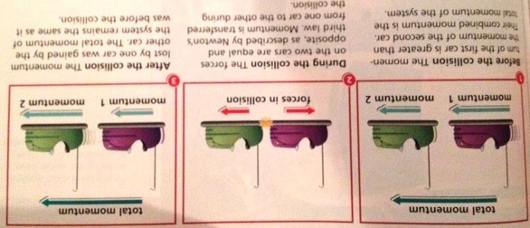
Conservation of Momentum
Conservation of Momentum states that the total momentum of a system of objects does not change, as long as no outside forces are acting on that system.

Slide 46
Conservation of Momentum
The combined momentum of both objects after a collision is the same as the combined momentum of both objects before the collision.
Collisions aren’t the only time momentum is conserved- it is also conserved any time the only forces acting on objects are action/reaction force pairs.

