Slide 1
Air Pressure Air molecules are moving constantly! They bounce off everything like rubber balls! They are bouncing off your body and everything around you right now! Each time an air molecule bounces off an object, it pushes (EXERTS FORCE) on that object. When billions of air molecules bounce off a surface, the force is spread over the area of that surface.

Slide 2
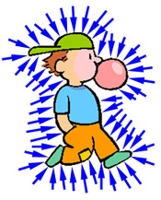
What is air pressure?
Air Pressure is the force of air molecules pushing on an area.
The greater the force, the higher the air pressure.
Air molecules move in all directions, so air pressure pushes in all directions.

Slide 3
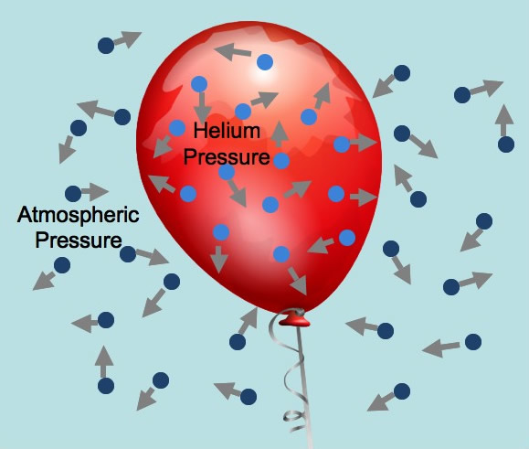
Air Pressure has weight…
When you hold your hand up, air is pushing down on it with weight greater than that of a bowling ball!
Why don’t you feel it?
Air pushes in ALL directions so it is also pushing your hand up. The opposite forces balance out. This same force keeps a blown up balloon from collapsing.

Slide 4
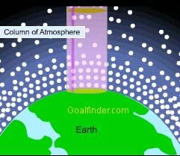
Air Pressure and Density are Related!
Both air pressure and density decrease as you move higher in the atmosphere.
In other words, as density decreases so does air pressure.
So the air at sea level is not only more dense, but also has higher air pressure.

Slide 5
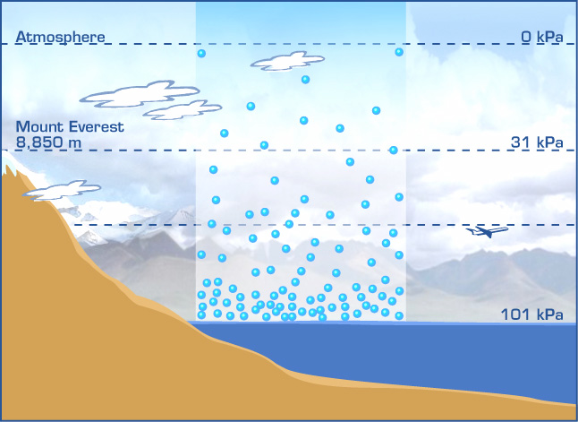

Slide 6
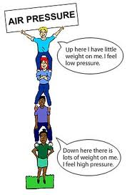
How does air pressure relate to the atmosphere?
Density and air pressure increase at lower altitudes because there is more air above them pushing down.
As air molecules move to higher altitudes there are less air molecules above them and more below them.
This means as air molecules reach higher altitudes the amount of air molecules in even higher altitudes pushing down on them decreases.

Slide 7
Air Pressure and Motion
Air pressure changes with altitude. It decreases as altitude increases.
However, air pressure can also vary within the same altitude.
The differences in air pressure cause air to move. Air moves from areas of high air pressure to areas of low air pressure.
Without varying air pressure air would not move!!
Air Pressure is measured using a BAROMETER.

Slide 8
Egg-celent ☺
http://www.youtube.com/watch?v=M_eScIAl8Dg

