Slide 1
Warm-up 2/25
BEHAVIOR SHEET ON DESK
Set up page 32 with page, date, and title: DNA/ CHROMOSOMES GUIDED NOTES
Attach your guided notes worksheet to this page
Get your Chrome Book, log in, and go to www.padlet.com

Slide 2
DNA and Chromosomes

Slide 3
What do you know about DNA? Chromosomes? Genetics?
http://www.brainpop.com/science/cellularlifeandgenetics/dna/

Slide 4
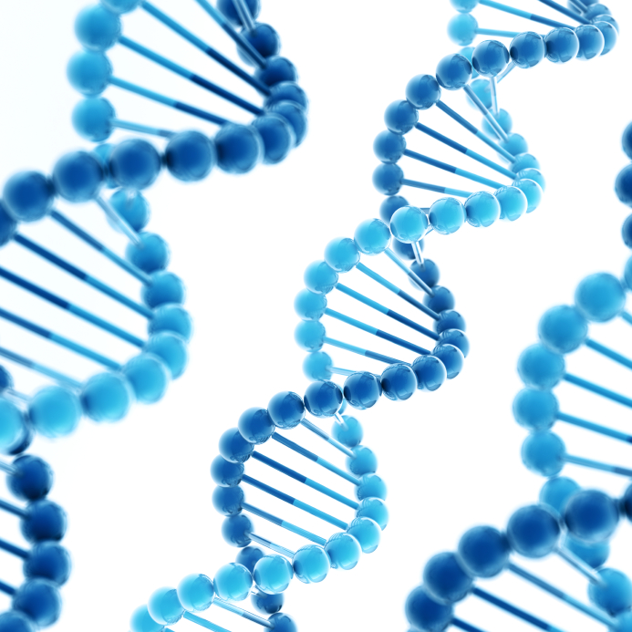
DNA
The genetic material in cells is called DNA (or deoxyribonucleic acid).
DNA is in the nucleus of a eukaryotic cell and it is a chemical that contains information growth and functions- it’s like the brain of the cell telling it what to do.
DNA is made of two strands and forms a twisted ladder or “double helix”.
DNA is wrapped around protein (like thread around a spool) and compacted into structures called chromosomes.
Human DNA would be 2 meters long if it wasn’t wrapped up inside the chromosome!

Slide 5
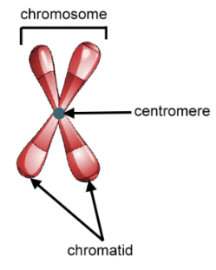
Chromosomes
Humans have 46 chromosomes, or 23 pair. The 23rd pair is what determines your gender.
Other species have different numbers of chromosomes. For example, a dog has 78 (39 pair) and corn has 20 (10 pair).
During cell division, chromosomes consist of 2 chromatids that are joined together by a centromere.

Slide 6
Why is cell division important anyway??
We are very different than other species.
BUT what we do have in common with them is that almost all multicellular organisms are made of trillions of cells.
Cell division is essential for growth, development, and repair.

Slide 7
Growth
In general, a larger organism doesn’t have larger cells than a smaller organism, it just has MORE.
Individual cells grow in size but there are limits to how large they can grow.
Cells need a high ratio of surface area to volume in order to function.
As a cell grows, that ratio decreases.
When a cell divides into two smaller cells, the ratio of surface area to volume for each cell increases again.
As a cell grows, more processes are needed for it to function, so its demand for instructions from DNA increases, but the amount of DNA stays the same.

Slide 8
Development
Although multicellular organisms begin as single cells, they grow into larger organisms through cell division, but cell division isn’t the only reason organisms develop.
During development, cells become specialized to perform particular functions.
They may take on different shapes or structures, become layered (skin cells), or become long and thin (nerve cells).
These cells still have the same DNA as the other cells, they are just specialized.

Slide 9
Repair
Think about when you cut yourself or broke one of your bones. Over time your body healed itself, right?
The body repairs injuries through cell division.
As cells age and die, they have to be replaced.
The human body is made of 200 different types of cells, which are replaced at different rates.
Every minute your skin loses about 40,000 cells and they are replaced with new ones.
Your brain cells last a very long time and don’t divide often.

