Slide 1
Earth’s Atmosphere

Slide 2
Atmosphere
The atmosphere is the whole layer of air that surrounds the Earth.
Supports and protects life
Gases keep the Earth warm and transport energy to different parts of the planet
VERY thin layer but we can’t live without it!

Slide 3
Altitude
Altitude is the distance above sea level
The thickness or thinness of air is measured by its density.
Density is the amount of mass in a given volume of a substance
Ex: A bowling ball has a higher density than a soccer ball even though they are the same size!
Density decreases in our atmosphere as we travel upward. (It contains less mass!)
So as altitude increases, density DECREASES!

Slide 4
Components of the Atmosphere
Most of the materials in our atmosphere are gases.
There are also tiny particles of dust, sea salt, and water droplets.
The gases in our air:
78% Nitrogen
21% Oxygen
1% Argon, Carbon Dioxide, and other gases

Slide 5
Components of the Atmosphere

Slide 6
Our Atmosphere Supports Life
The gases in our air provide support that is vital to life!
Nitrogen promotes plant growth and is an important chemical that makes up living things.
Oxygen is necessary for plant and animal life processes.
Carbon dioxide and water are used by plants to make food.

Slide 7
Cycles
Cycles are processes that repeat over and over.
Ongoing processes and sudden change can influence the amount of some gases in the air.
The most important cycles on our planet are:
Carbon cycle
Nitrogen cycle
Water cycle

Slide 8
Carbon Cycle
Carbon and oxygen gases constantly circulate (or cycle) among plants, animals, and the atmosphere
Animals inhale air, use the oxygen, and exhale the carbon dioxide and water.
Plants take in carbon dioxide, and release oxygen in the process of photosynthesis

Slide 9
Nitrogen Cycle
Most living things can’t obtain nitrogen directly from the air
Bacteria in the roots of plants changes nitrogen into nitrates
Plants absorb the nitrates and use them to make proteins
Animals eat the plants and obtain the nitrates
Animals die and decomposers return the nitrogen to the soil and the atmosphere

Slide 10
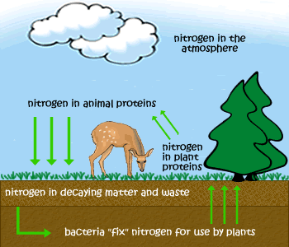
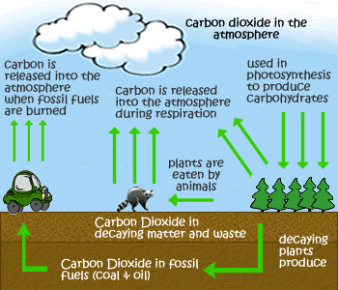
Nitrogen and Carbon Cycles

Slide 11
Water Cycle
Different forms of water cycle between the Earth’s surface and its atmosphere.
Evaporation- liquid water from lakes and oceans changes into gas and enters the atmosphere.
Transpiration- plants release water vapor from their leaves.
Precipitation- liquid water falls from the atmosphere in the form of rain, snow, sleet, or hail.

Slide 12
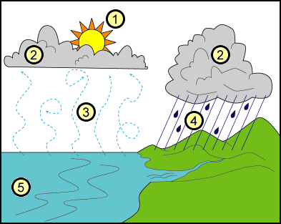
The Water Cycle

