Slide 1
Logging into Chromebooks
Log into your Chromebook using your Gaggle account info. This is the same way you should have logged into the Chromebooks for MAP testing.
Username: first initial last name last 4 of student ID number
Password: birthday (yymmdd)

Slide 2
Setting up your Google Classroom Account

Slide 3
Setting up your Google Classroom Account
You should be able to log into your Google Drive.
Type the following link: https://classroom.google.com/c/NTk1NzA4N1pa or access the link from my website
You should be asked for a class code. Red block’s class code is: qetpp3x
WRITE THIS CODE ON THE FRONT PAGE OF YOUR AGENDA! WE WILL USE IT ALL YEAR!!

Slide 4
Setting up your Google Classroom Account
You should be able to log into your Google Drive.
Type the following link: https://classroom.google.com/c/NTk2MTc2Mlpa or access the link from my website
You should be asked for a class code. Yellow block’s class code is: zptp6o6
WRITE THIS CODE ON THE FRONT PAGE OF YOUR AGENDA! WE WILL USE IT ALL YEAR!!

Slide 5
Setting up your Google Classroom Account
You should be able to log into your Google Drive.
Type the following link: https://classroom.google.com/c/NTk1NzYxMlpa or access the link from my website
You should be asked for a class code. Green block’s class code is: f1lnvhr
WRITE THIS CODE ON THE FRONT PAGE OF YOUR AGENDA! WE WILL USE IT ALL YEAR!!

Slide 6
Setting up your Google Classroom Account
You should be able to log into your Google Drive.
Type the following link: https://classroom.google.com/c/ODUxODgwOFpa or access the link from my website
You should be asked for a class code. Blue block’s class code is: szkvro
WRITE THIS CODE ON THE FRONT PAGE OF YOUR AGENDA! WE WILL USE IT ALL YEAR!!

Slide 7
How to Complete an Assignment in Google Classroom

Slide 8
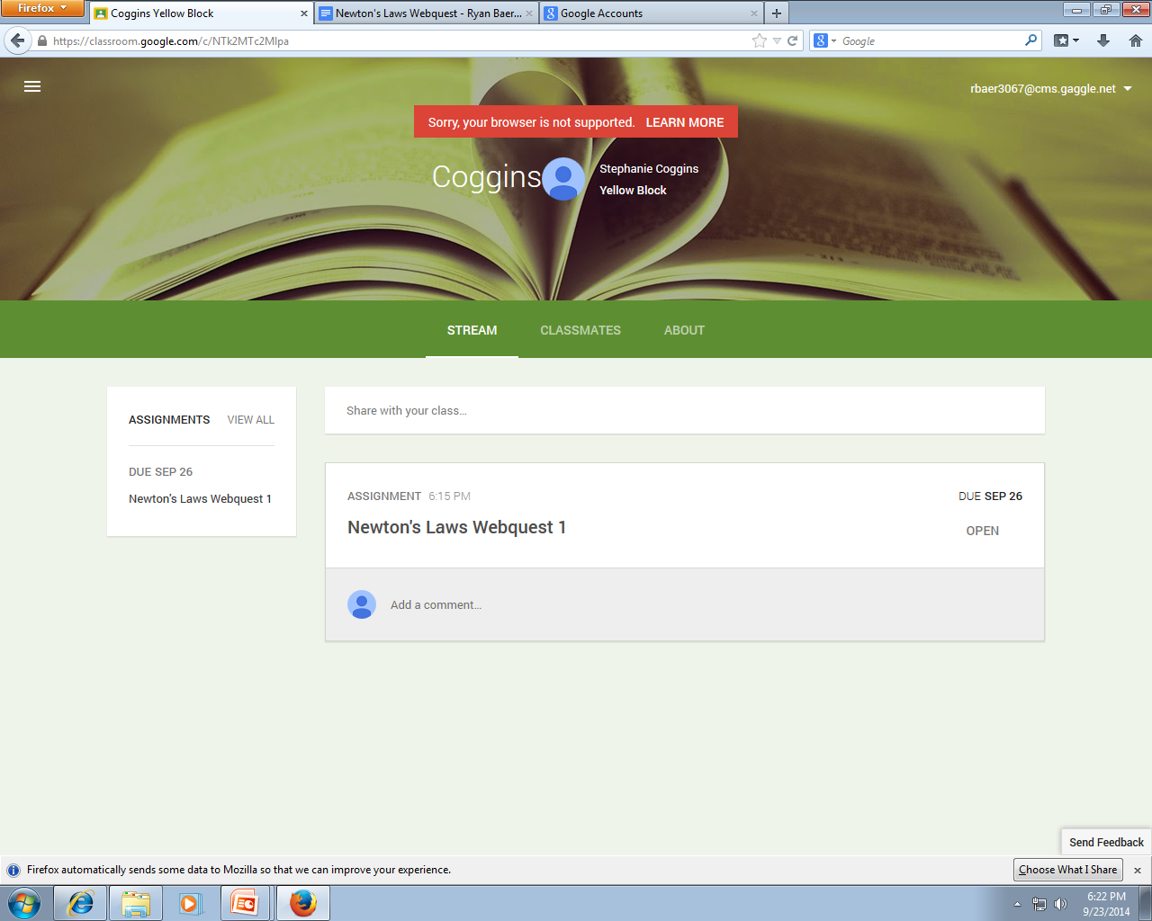
1. Click on the assignment you wish to complete.

Slide 9
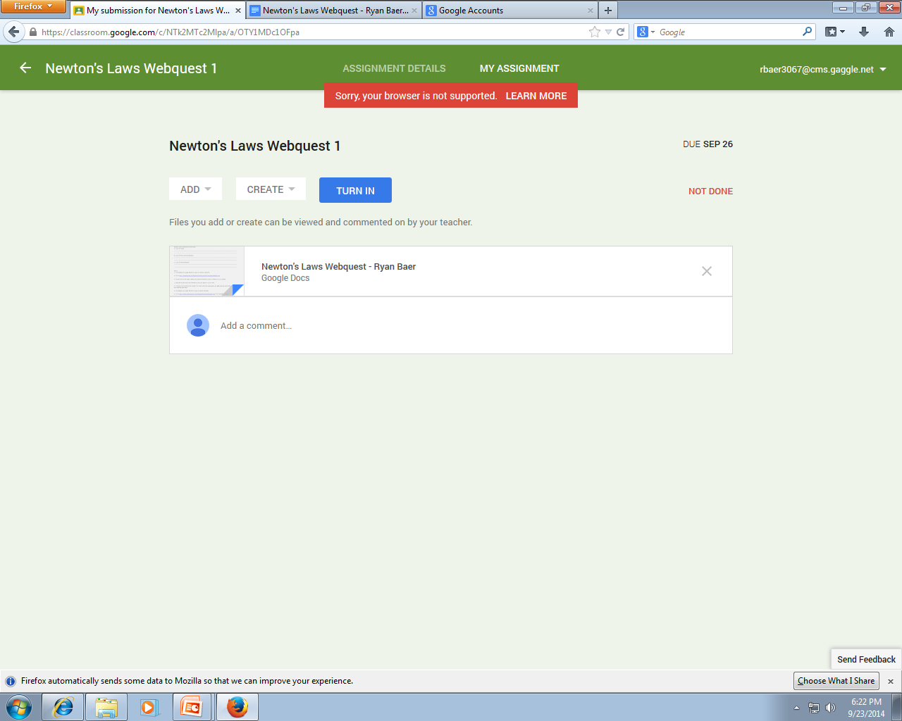
2. It will bring you to a new screen-click on the assignment again

Slide 10
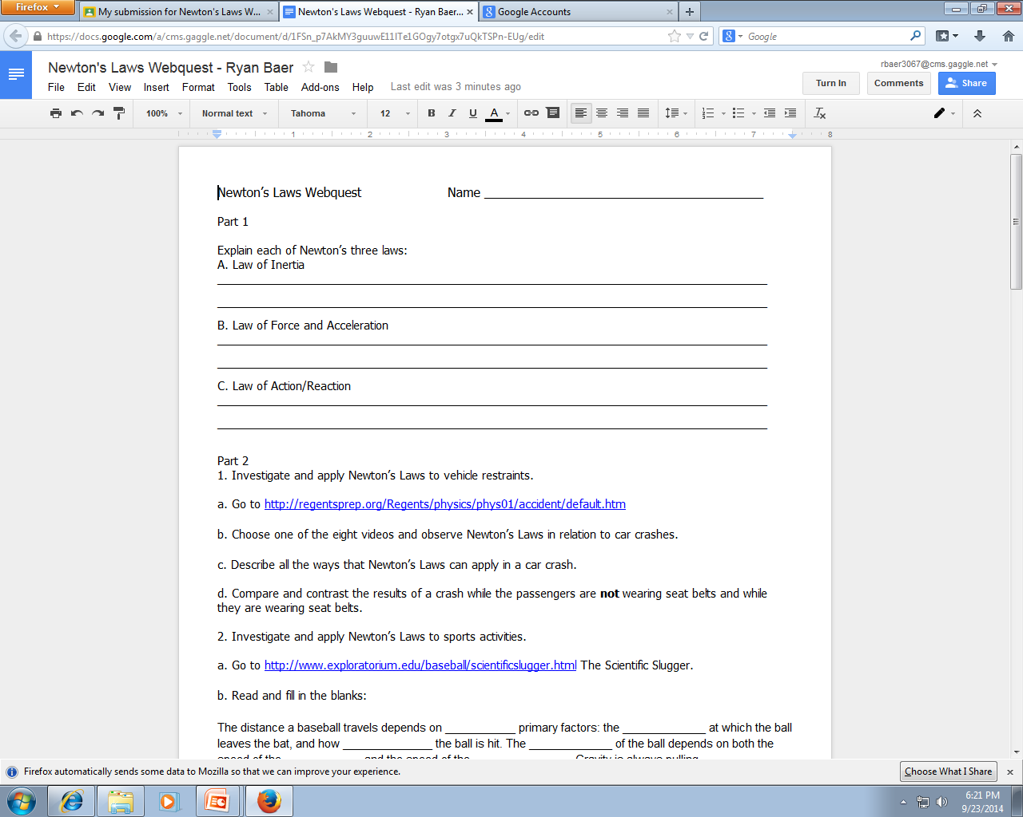
3. Your assignment will open in Google Docs and you will now be able to start working on it.

Slide 11
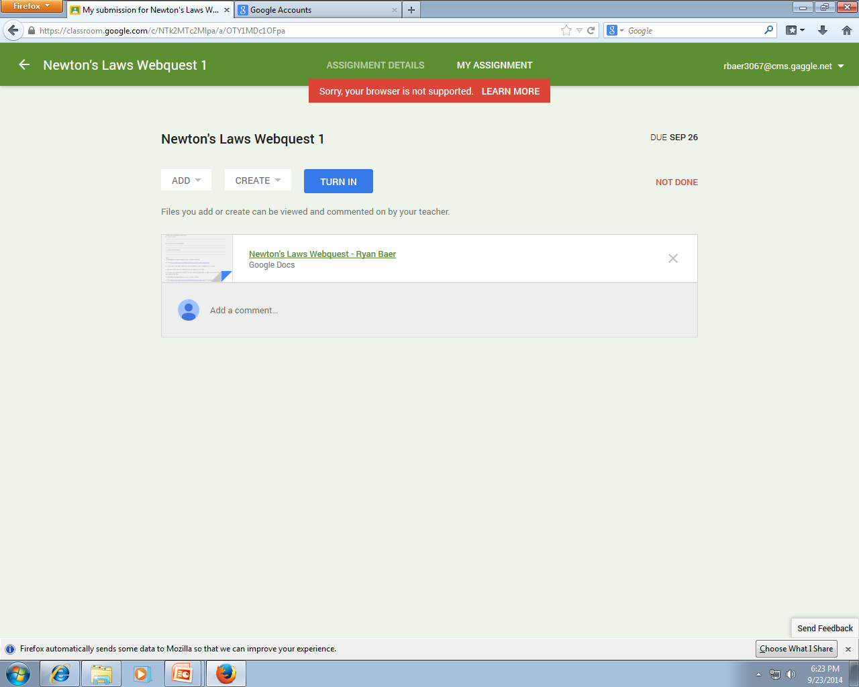
4. X out of the Google Doc once you’re finished. Remember you don’t need to save, it auto-saves. You will come back to this screen. Now you’re ready to TURN IN.

Slide 12
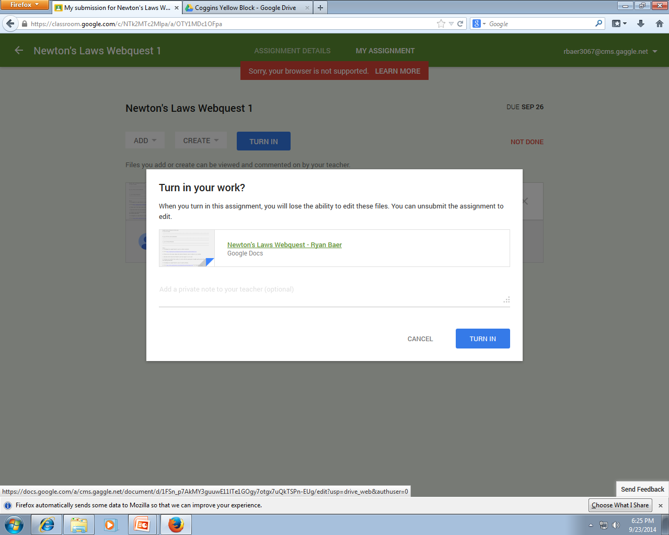
4. A pop-up window will appear. You will be prompted “Turn in your work?” Select TURN IN.

Slide 13
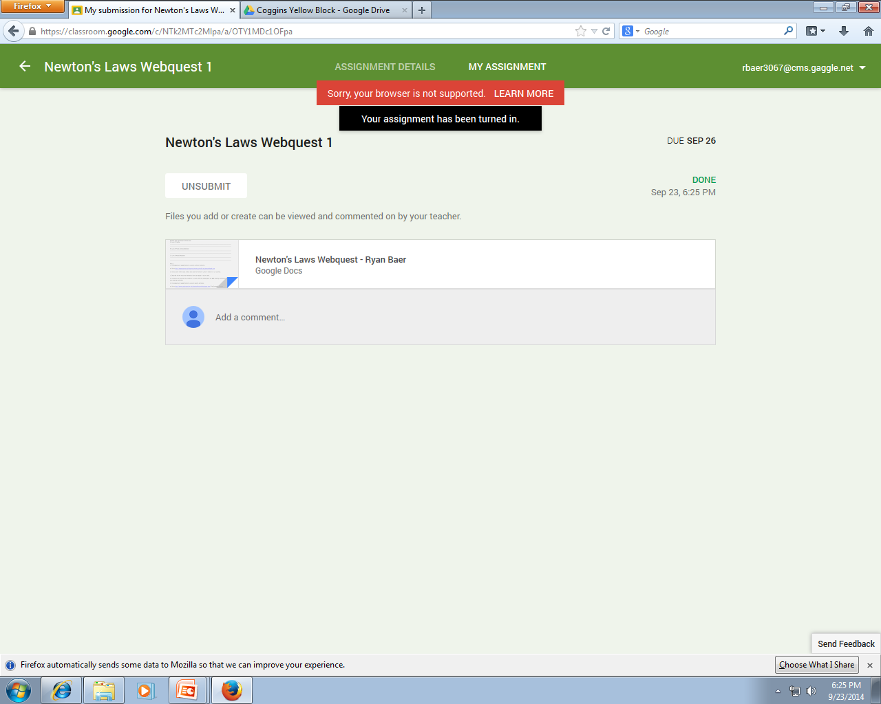
4. You will receive a confirmation at the top in a black box. You’re done!

