Slide 1
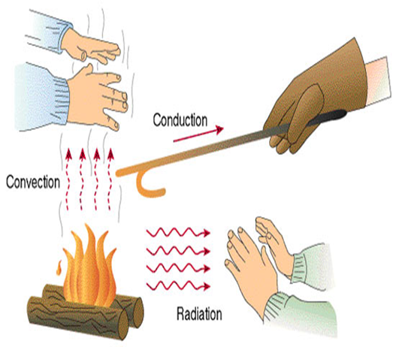
Understanding Heat Transfer:
Conduction, Convection and Radiation

Slide 2
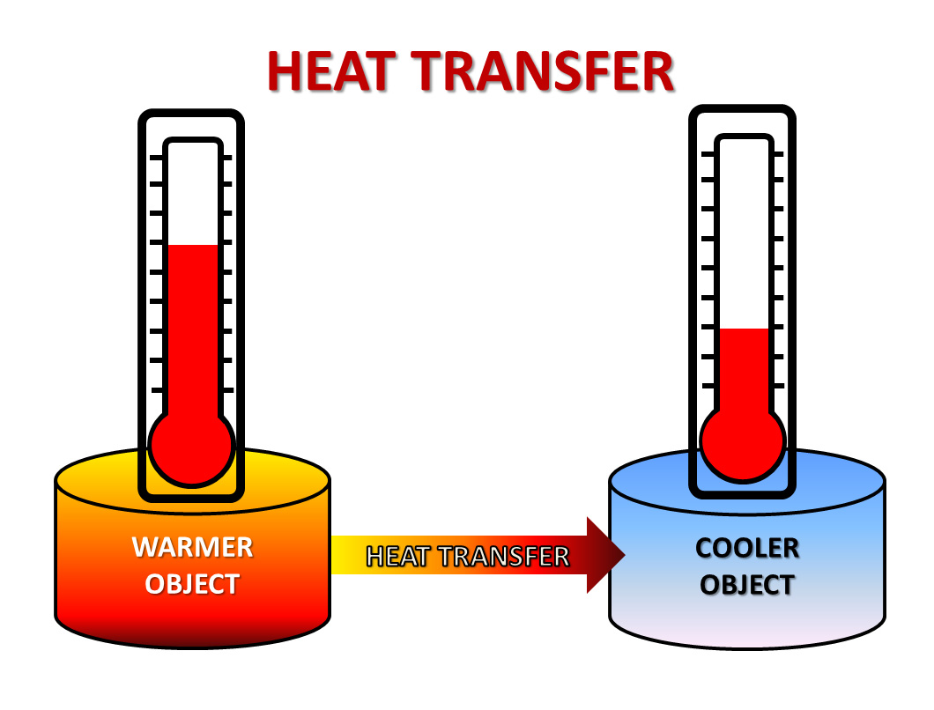
Heat Transfer
Heat always moves from a warmer place to a cooler place.
Hot objects in a cooler room will cool to room temperature.
Cold objects in a warmer room will
heat up to room temperature.

Slide 3
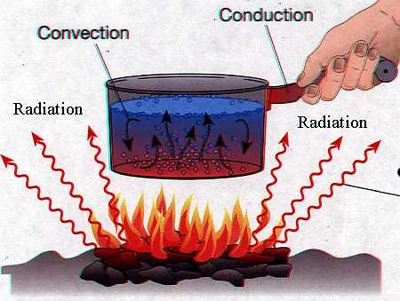
Heat Transfer Methods
Heat transfers in three ways:
  Conduction
  Convection
  Radiation

Slide 4
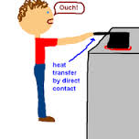
Conduction
The transfer of heat energy from one substance to another through direct contact. Heat transfers from the warmer part of the object to the cooler part of the object

Slide 5
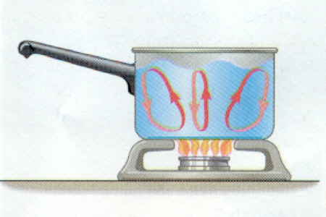
Convection
Transfer of heat through the movement of particles. Convection occurs in liquids and gases. This occurs in a circular motion as warm particles rise and cooler particles sink.

Slide 6
Cold air sinks
Convection Heat
Where is the freezer compartment put in a fridge?
Freezer compartment
It is warmer at the bottom, so this warmer air rises and a convection current is set up.
It is put at the top, because cool air sinks, so it cools the food on the way down.

Slide 7
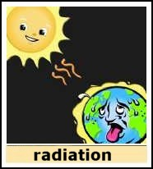
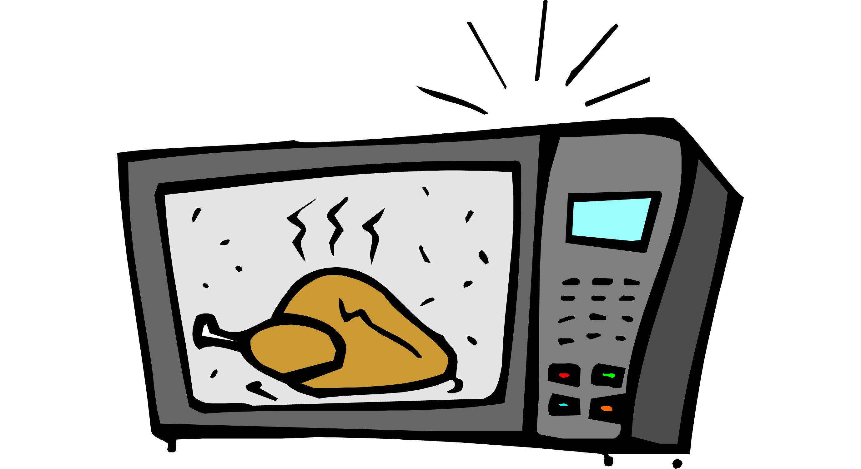
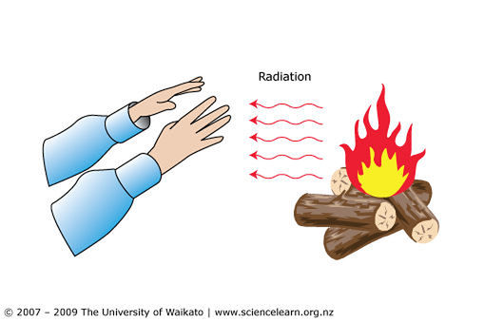
Radiation
Energy that travels across distances as certain types of waves.

