Slide 1
Warm-up 2/27
BEHAVIOR SHEETS ON DESK!
Set up page 33 with page, date, and title: CELL PROCESSES/PROTISTS TEST CORRECTIONS
Set up page 34 with page, date, and title: BILL NYE GENES. DO NOT glue this in.
Set up page 35 with page, date, and title: AMOEBA SISTERS CELL DIVISION. Glue this in.
Set up page 36 with page, date, and title: CELL CYCLE GUIDED NOTES. Glue this in.
Get your Chrome Books, log into Blendspace, and get started on the Intro to Mitosis II Blendspace.

Slide 2
Warm-up 2/27
BEHAVIOR SHEETS ON DESK!
Set up page 37 with page, date, and title: CELL CYCLE FLOWMAP
Set up page 38 with page, date, and title: CELL CYCLE FILL IN THE BLANK
Set up page 39 with page, date, and title: CELL CYCLE WORKSHEET

Slide 3
The Cell Cycle

Slide 4
The Cell Cycle
The cell cycle is the normal sequence of development and division of a cell.
The cell cycle consists of two main parts:
Interphase- the cell carries out its functions
Cell division- consists of mitosis and cytokinesis
ALL CELLS DIVIDE BUT ONLY EUKARYOTES UNDERGO MITOSIS!
As a result of cell division, the original (parent) cell separates into two genetically identical daughter cells.

Slide 5
The Cell Cycle

Slide 6
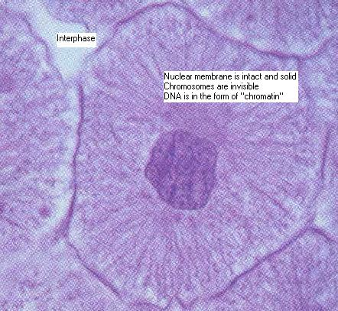
INTERPHASE
THE PART OF THE CELL CYCLE WHERE THE CELL IS NOT DIVIDING.
The cell grows about twice its original size.
It carries out normal activities(cellular transport, cellular respiration).
Changes that occur are in preparation for cell division. DNA is exactly duplicated so that after cell division occurs each new cell gets a complete set of DNA.

Slide 7
MITOSIS
Mitosis is the part of the cell cycle where the nucleus divides.
Remember the DNA is in the nucleus!
Prokaryotes DO NOT undergo mitosis because they have no nucleus.
The function of mitosis is to move the DNA and other material in the parent cell into position for cell division.

Slide 8
Steps of Mitosis
PROPHASE- chromosomes form
METAPHASE- chromosomes line up
ANAPHASE- chromosomes separate
TELOPHASE- nuclei form

Slide 9
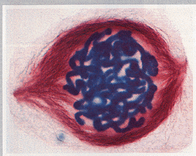
PROPHASE
CHROMOSOMES FORM
DNA in the nucleus condenses and becomes visible (under a microscope).
Each chromosome consists of two chromatids held together by a centromere.
The membrane around the nucleus disappears.

Slide 10
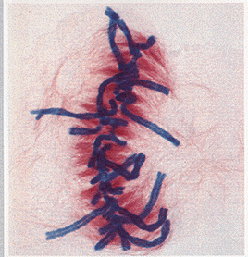
METAPHASE
CHROMOSOMES LINE UP
Chromosomes line up in the middles of the cell, “along the equator”.

Slide 11
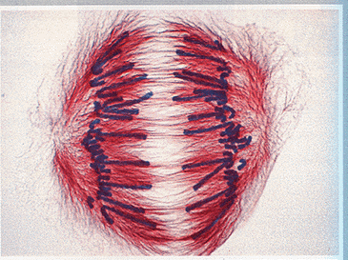
ANAPHASE
CHROMOSOMES SEPARATE
Chromatids split, resulting in two separate identical chromosomes.
These chromosomes are pulled onto separate sides of the cell.

Slide 12
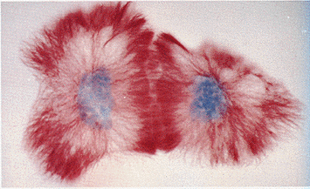
TELOPHASE
NUCLEI FORM
New nuclear membrane forms around each group of chromosomes.
Chromosomes return to their threadlike form.

Slide 13
CYTOKINESIS
Cytokinesis is the final stage of the cell cycle.
It is the division of the parent cell’s cytoplasm.
Cytokinesis occurs immediately after mitosis.
Once complete, the two daughter cells are completely separated, each surrounded by its own cell membrane. They are genetically identical to their parent cell, but smaller.

